Slide 1
Document Search Engine
A Python-based search engine for document title and content analysis
Presented By: Ayesha Nadeem, 2021-CS-9

Slide 2
Agenda
01
02
03
04
05
06
Overview
Preprocessing
Gathering Documents
Ranking Algorithm
Part-of-Speech (POS) Tagging & Noun Extraction
Building an Inverted Index

Slide 3
01
Overview

Slide 4
Overview
Objective
Build a search engine capable of finding documents based on title and content.
Enable efficient noun-based search in text files.
Key Features
Processes text files in a folder.
Tokenizes and lemmatizes words.
Extracts nouns to create an inverted index.
Ranks documents based on noun relevance to a search query.
Document Upload
Noun Extraction
Indexing
Search
Results

Slide 5
02
Gathering Documents

Slide 6
Gathering Documents
Purpose
Collects all .txt files from a specified folder path
Reads each file’s contents to create a dataset that can be used by other parts of the program.
Process
Opens each text file, reads content, and stores it in a list of dictionaries with title and content

Slide 7
03
Preprocessing

Slide 8
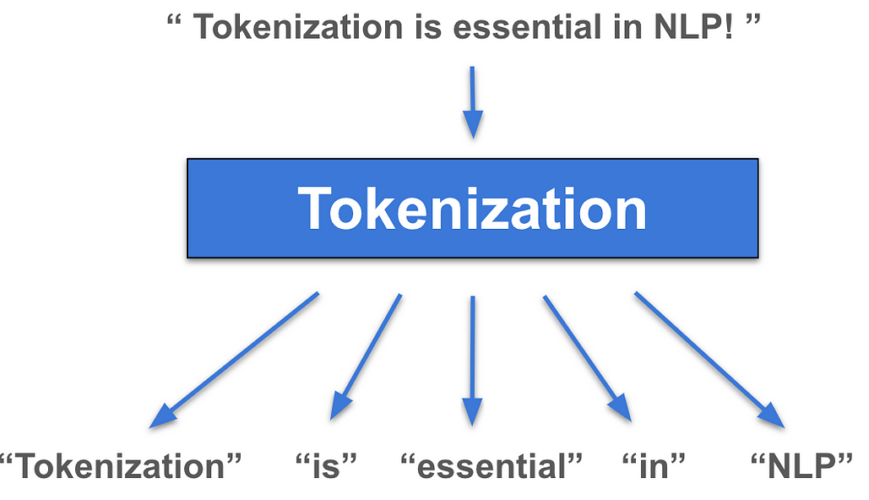
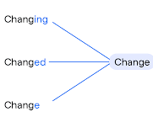
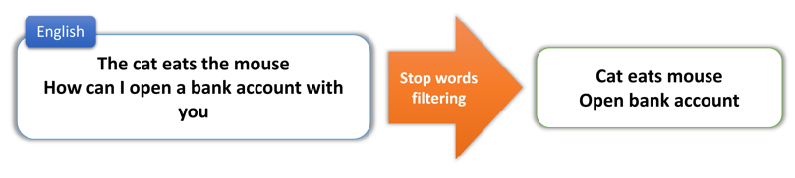
Preprocessing
Purpose
Prepares raw text for analysis by cleaning and structuring it.
To simplify the text and remove noise for further processing
Steps Involved
Tokenization
2. Lemmatization
3. Stop Words Removal

Slide 9
04
Part-of-Speech (POS) Tagging & Noun Extraction

Slide 10
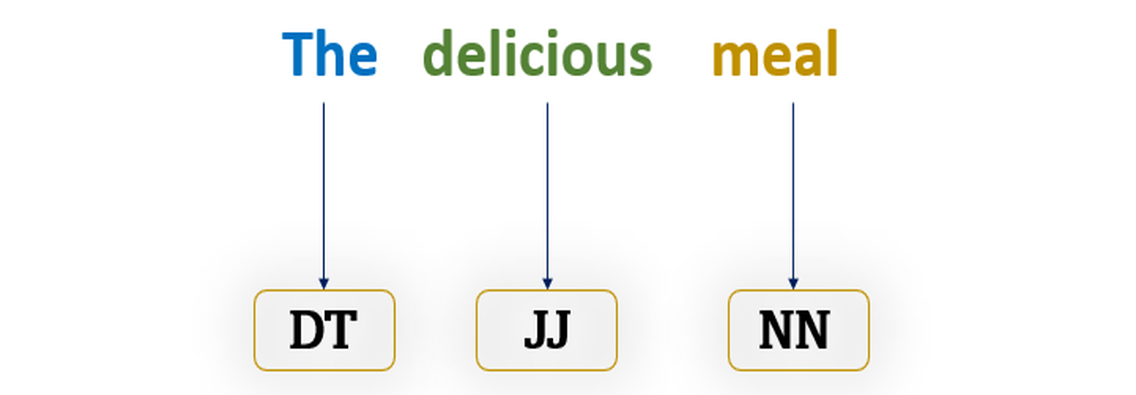
Part-of-Speech (POS) Tagging
Purpose
Assigns grammatical roles (like noun, verb, etc.) to each word.
Helps in filtering and focusing on specific types of words for search indexing.

Slide 11
Noun Extraction
Purpose
Identify and extract nouns from text as they represent core subjects or topics.
Why Nouns?
Nouns usually denote key concepts, themes, or entities in the text, such as people, places, or objects.
By focusing on nouns, the search engine indexes terms most likely to reflect document topics.

Slide 12
05
Building an Inverted Index

Slide 13
Building an Inverted Index
Purpose
Special noun acts as an index entry that maps to documents, making searches faster and reducing the need to scan entire texts repeatedly
How it works
For each document, splits content by paragraphs and extracts special nouns
Counts each noun’s occurrences in the document. Only nouns appearing more than once are recorded to emphasize key topics.
Adds nouns to an inverted_index dictionary, where keys are nouns, and values are dictionaries of document titles with count frequencies

Slide 14
06
Ranking Algorithm

Slide 15
Ranking Algorithm
Purpose
Helps in ordering results based on how closely they match the search query
Process
Counts each noun’s occurrence across documents, summing for each match.
Documents with higher counts for query nouns rank higher.

Slide 16
Thank You

